Slide 1
Introduction to Universal Windows Platform(UWP)
WPF & XAML

Slide 2
To do - Today
Understanding WPF and UWP.
Introduction to XAML and VS Blend.

Slide 3

What is UWP?
Universal Windows Platform (UWP) is an open source API created by Microsoft and first introduced in Windows 10.
The purpose of this platform is to help develop universal apps that run on Windows 10, Windows 10 Mobile, Xbox one and HoloLens without the need to be re-written for each.
It supports Windows app development using C++, C#, VB.NET, and XAML. The API is implemented in C++, and supported in C++, VB.NET, C#, F# and JavaScript.

Slide 4
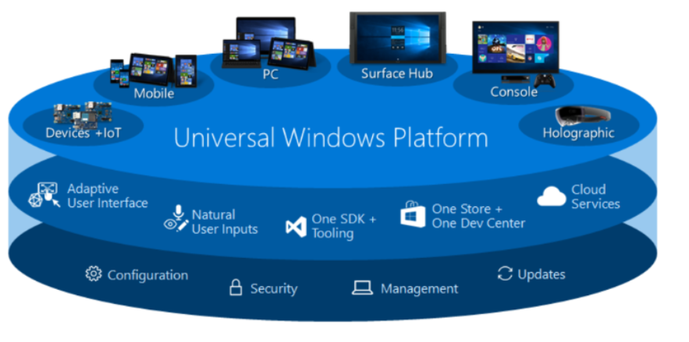

Slide 5
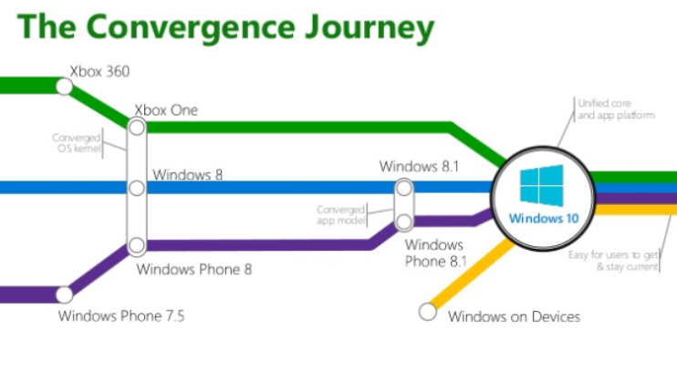

Slide 6
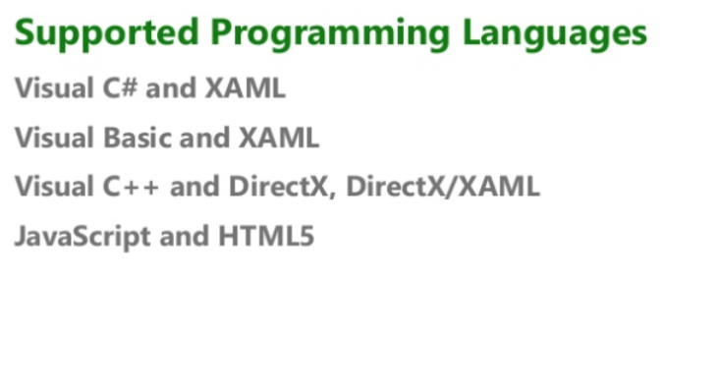

Slide 7
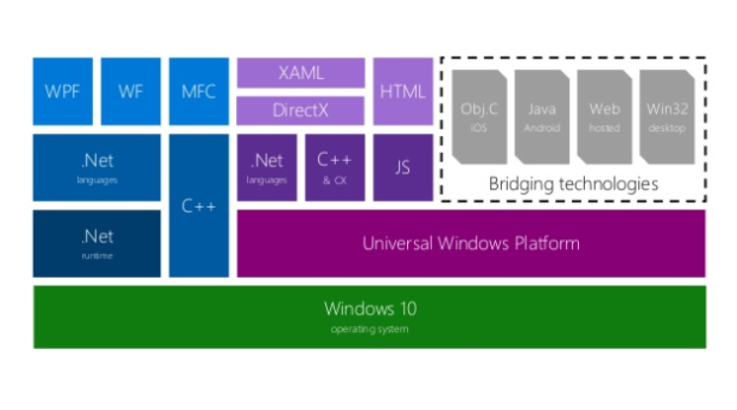

Slide 8
Windows Presentation Foundation
(WPF)

Slide 9
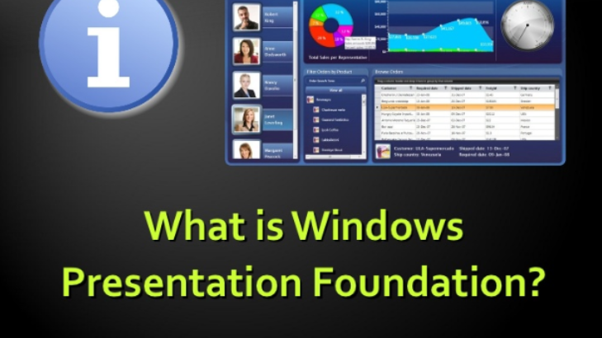

Slide 10
WPF
Windows Presentation Foundation (WPF) is a graphical subsystem by Microsoft for rendering user interfaces in
Windows-based applications. WPF, previously known as "Avalon", was initially released as part of .NET Framework 3.0 in 2006.

Slide 11
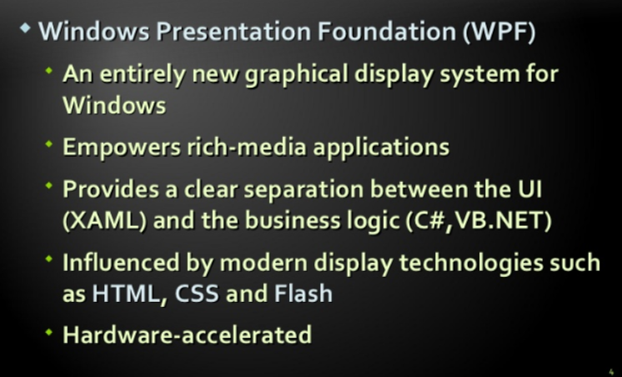

Slide 12
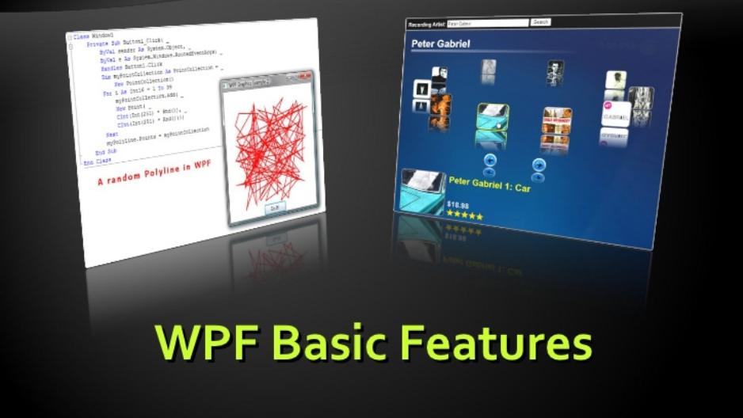

Slide 13
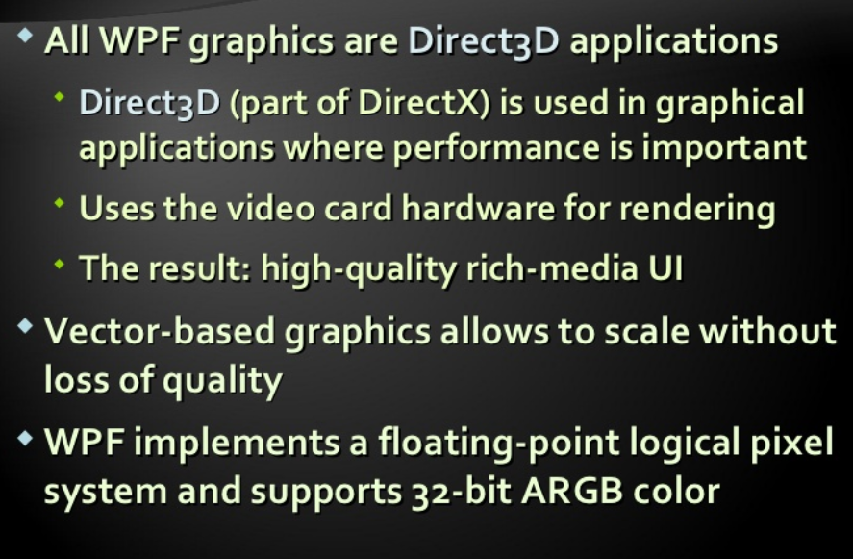
Vector Graphics

Slide 14
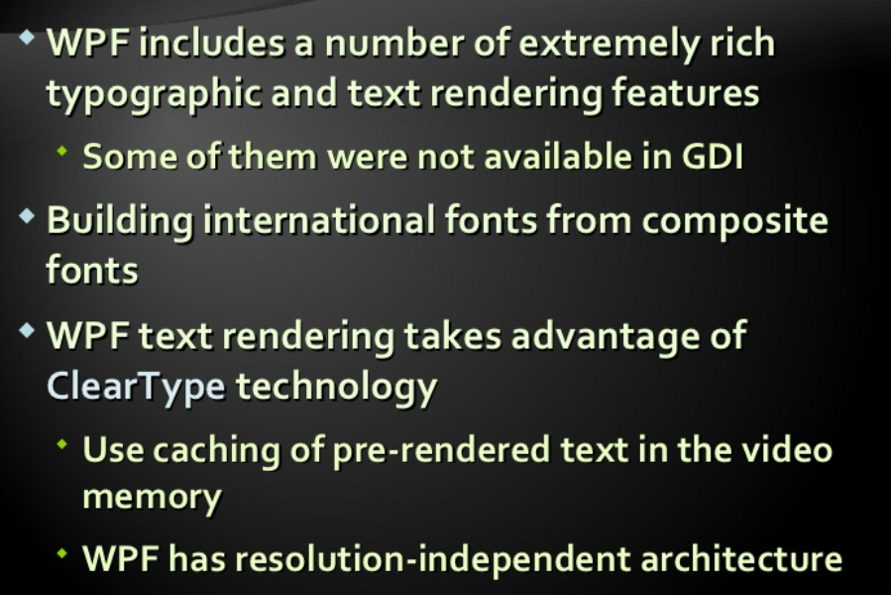
Rich Text Model

Slide 15
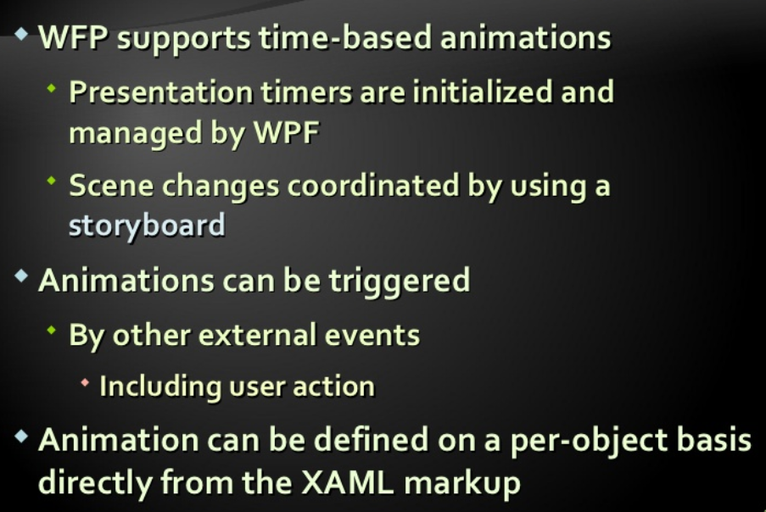
Animation

Slide 16
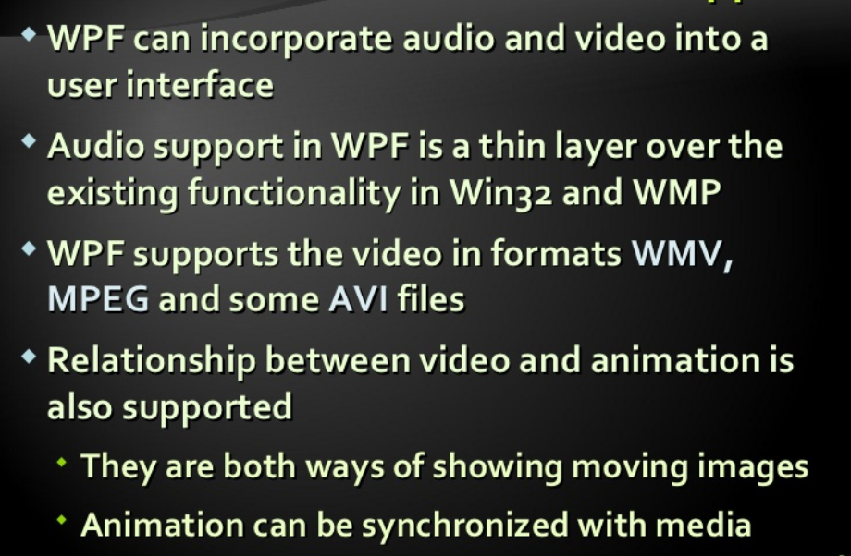
Audio and Video support

Slide 17
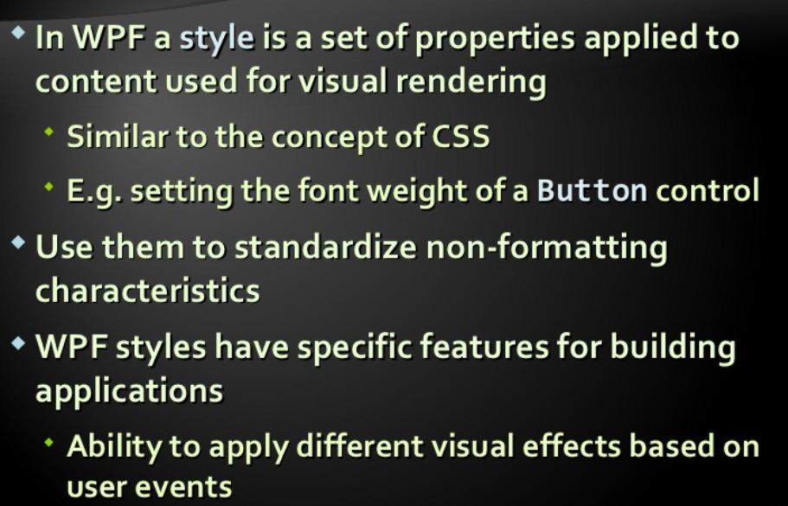
Styles and sheets

Slide 18
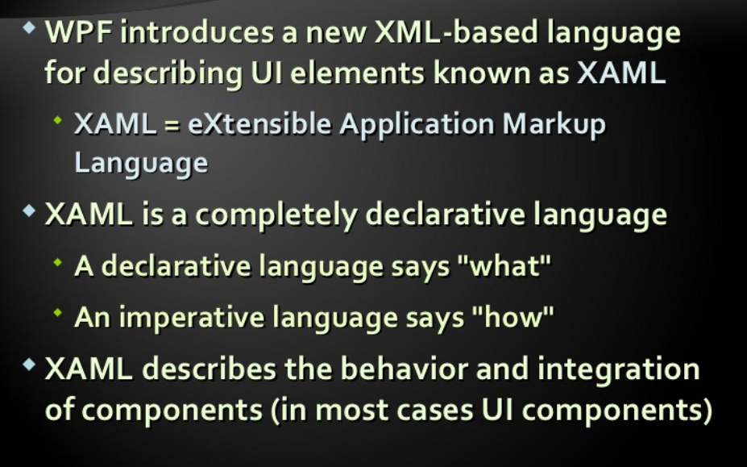
Declarative UI with XAML

Slide 19
eXtensible Application Markup Language
…
(XAML)

Slide 20
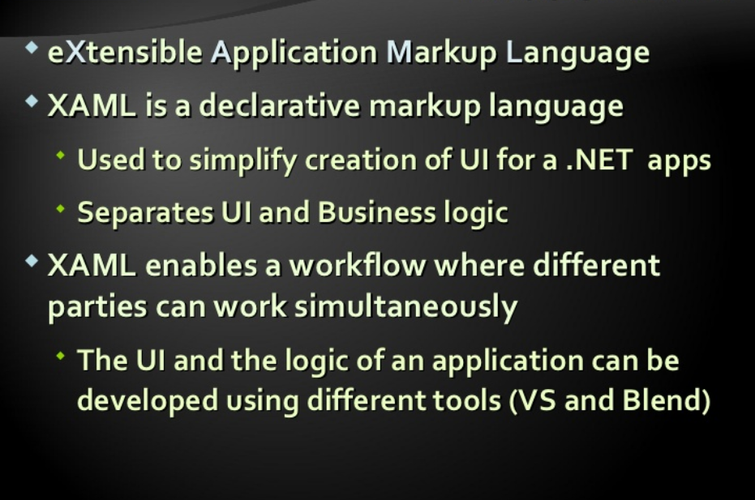
What is XAML?

Slide 21
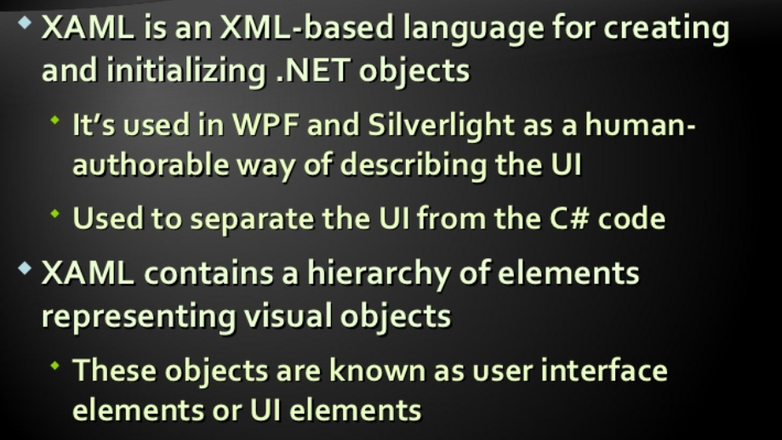

Slide 22


Slide 23
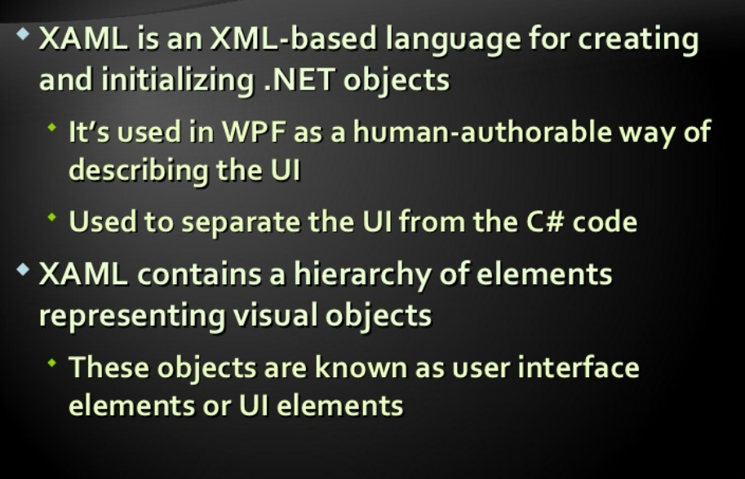
XAML BASICS

Slide 24
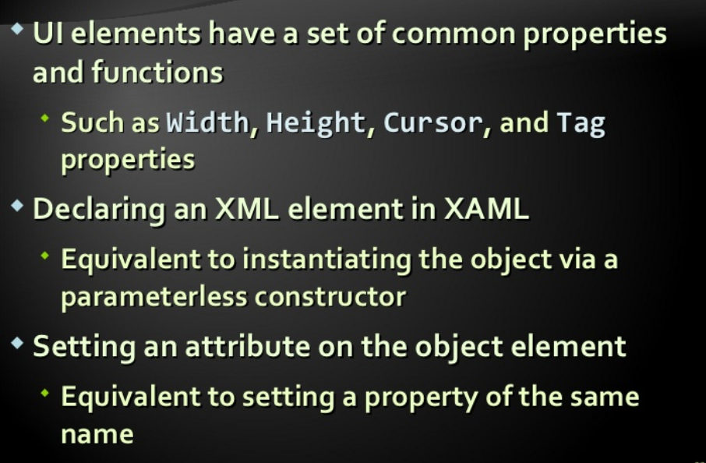
Elements and attributes

Slide 25
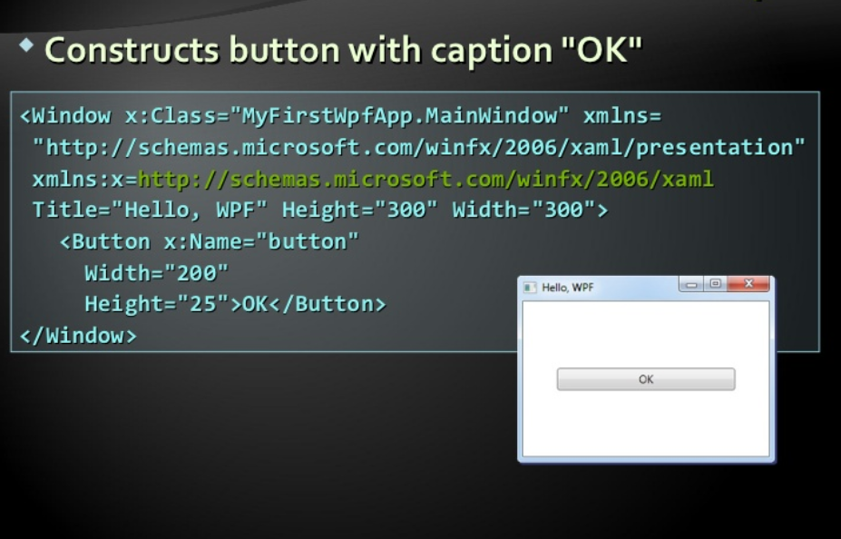
XAML BASICS- EXAMPLE

Slide 26
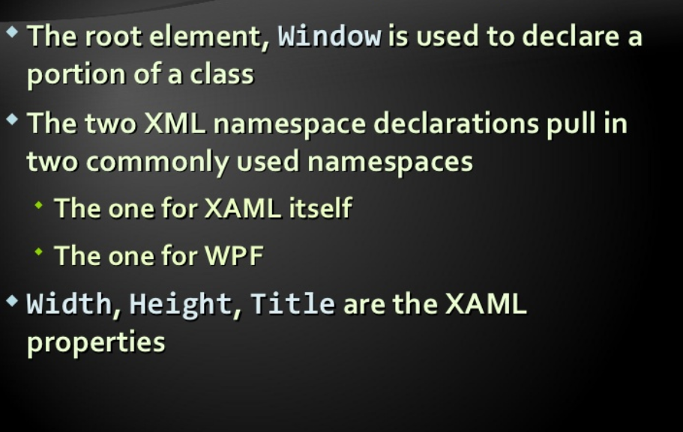
Example - Explanation

Slide 27
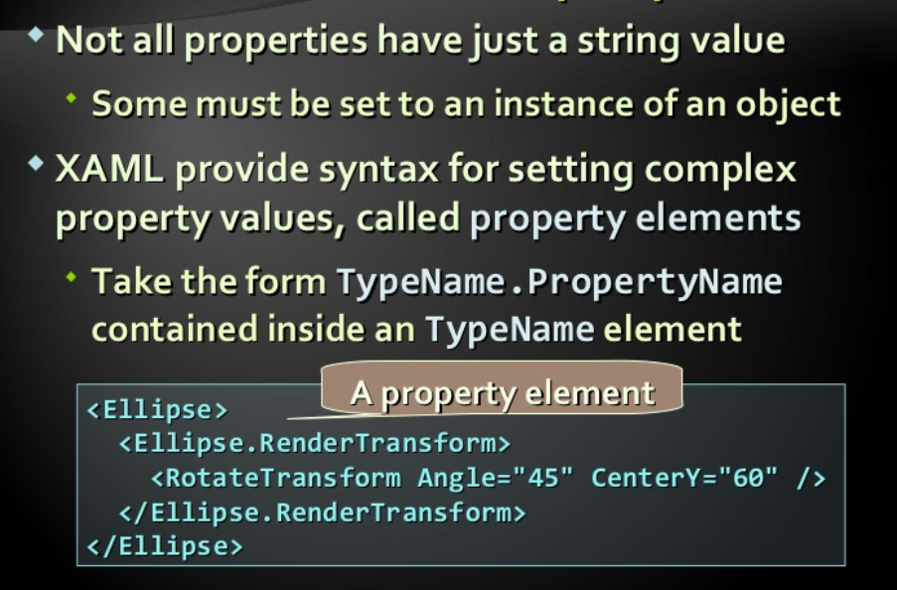
Property Elements

Slide 28
Alignment, margin, padding
In UWP apps, most user interface (UI) elements inherit from the FrameworkElement class.
Every FrameworkElement has dimensions, alignment, margin, and padding properties, which influence layout behavior.
The following guidance provides an overview of how to use these layout properties to make sure your app's UI is legible and easy to use in any context

Slide 29
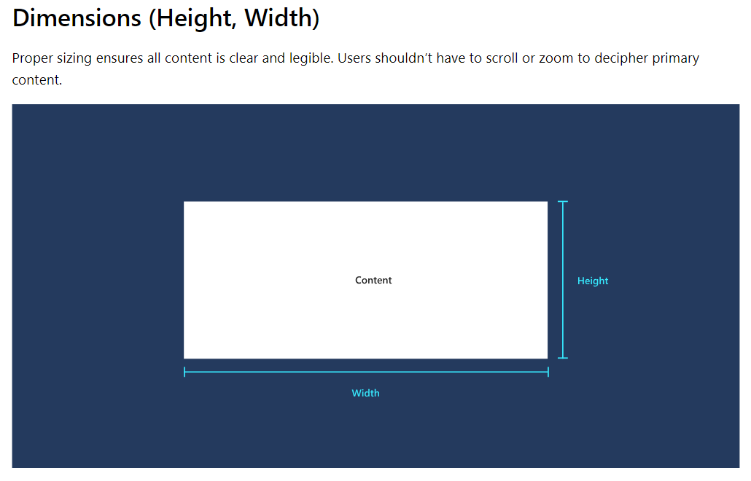

Slide 30
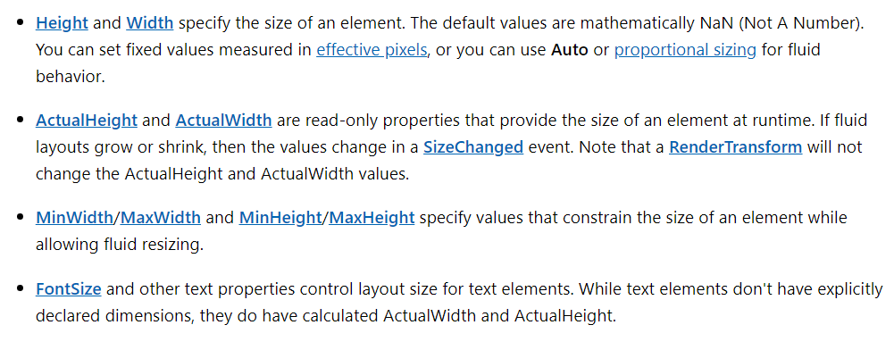

Slide 31
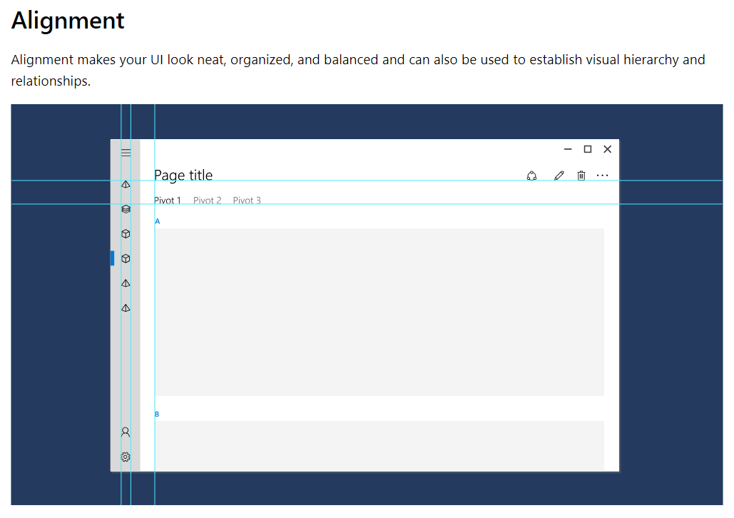

Slide 32
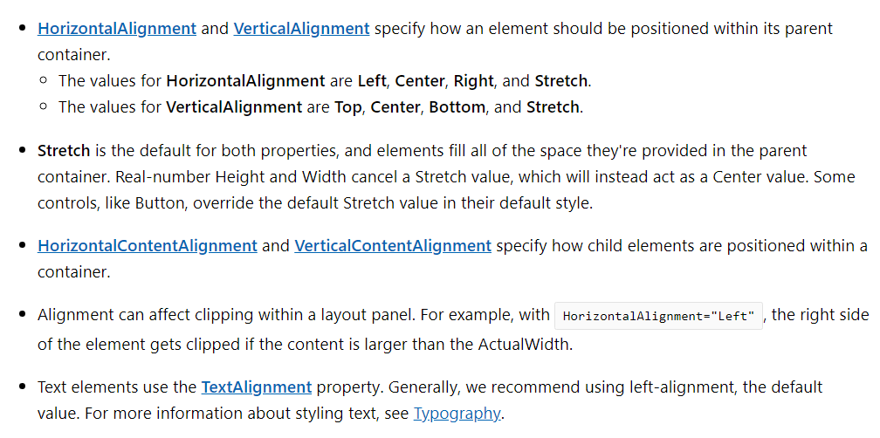

Slide 33
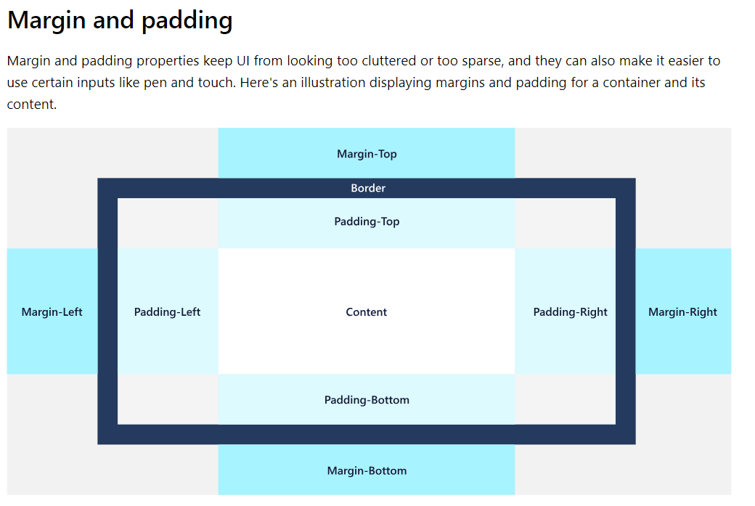

Slide 34
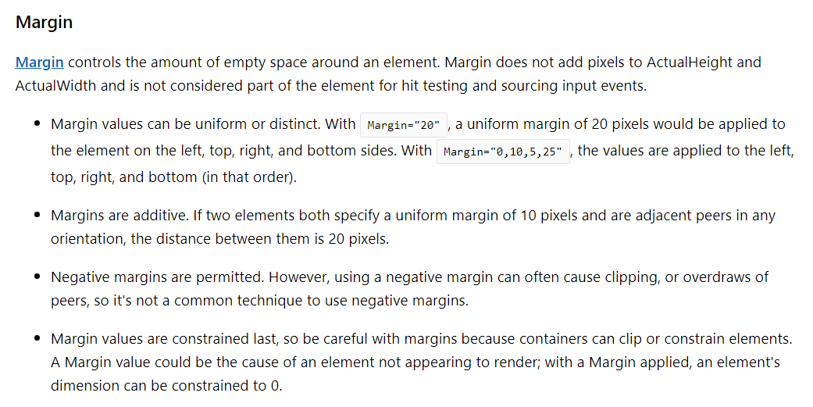

Slide 35
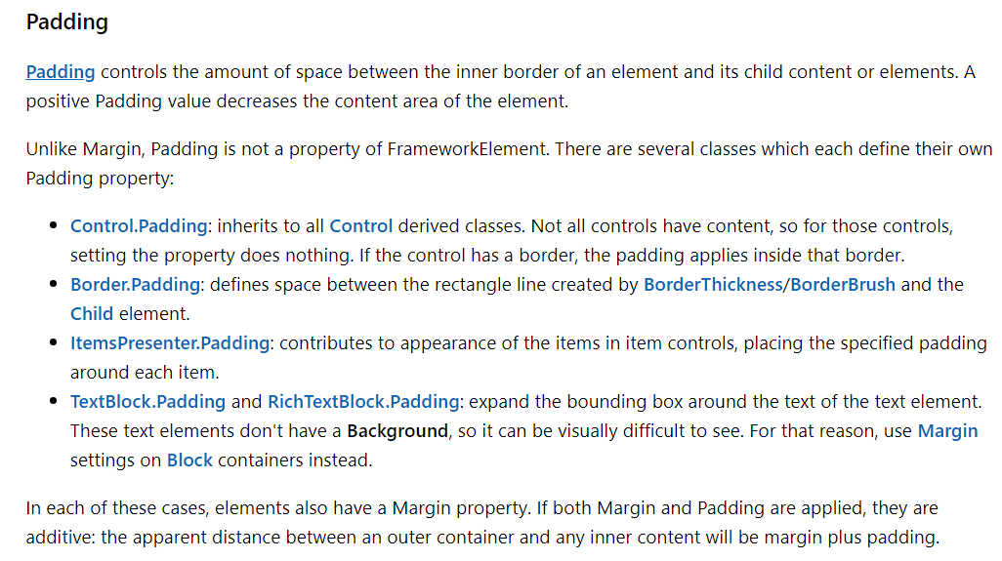

Slide 36
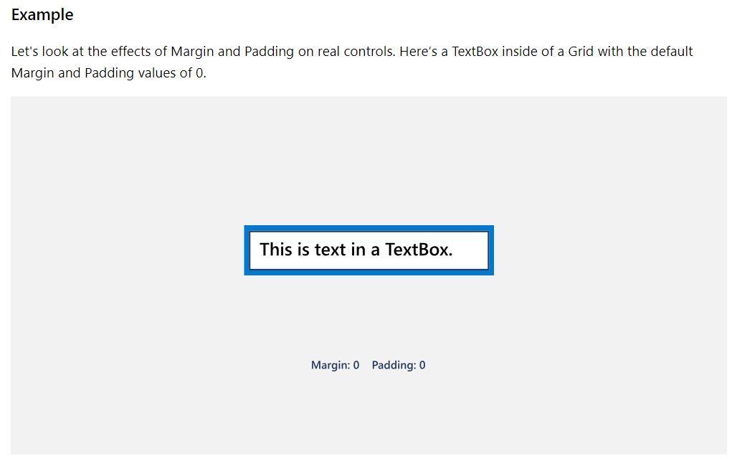

Slide 37
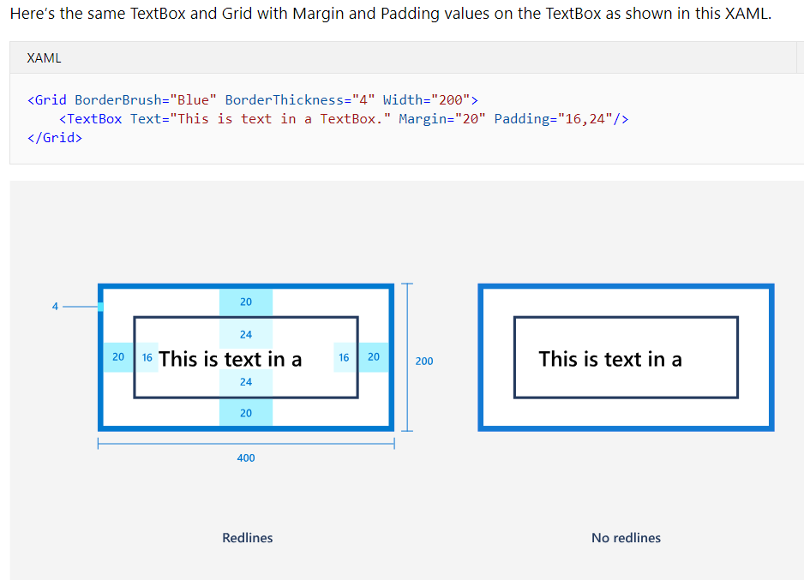

Slide 38
Important links for research
What is XAML? https://docs.microsoft.com/en-us/dotnet/framework/wpf/advanced/xaml-overview-wpf
WPF overview. https://docs.microsoft.com/en-us/visualstudio/designers/introduction-to-wpf?view=vs-2017
Blend for Visual Studio overview. https://docs.microsoft.com/en-us/visualstudio/designers/creating-a-ui-by-using-blend-for-visual-studio?view=vs-2017
Responsive layouts with XAML. https://docs.microsoft.com/en-us/windows/uwp/design/layout/layouts-with-xaml
Alignment, margin, padding. https://docs.microsoft.com/en-us/windows/uwp/design/layout/alignment-margin-padding
What’s a UWP app? https://docs.microsoft.com/en-us/windows/uwp/get-started/universal-application-platform-guide

Slide 39
Thank you!
Ooko Emmanuel.

